Slide 1


CSE424 (Pattern Recognition)
Group-11
RESEARCH PROJECT TOPIC TEAM PRESENTATION
TOPIC:
MULTI-MODAL ANALYSIS FOR MAPPING PSYCHIATRIC DISORDERS USING HYBRID CNN-SVM MODEL

Slide 2
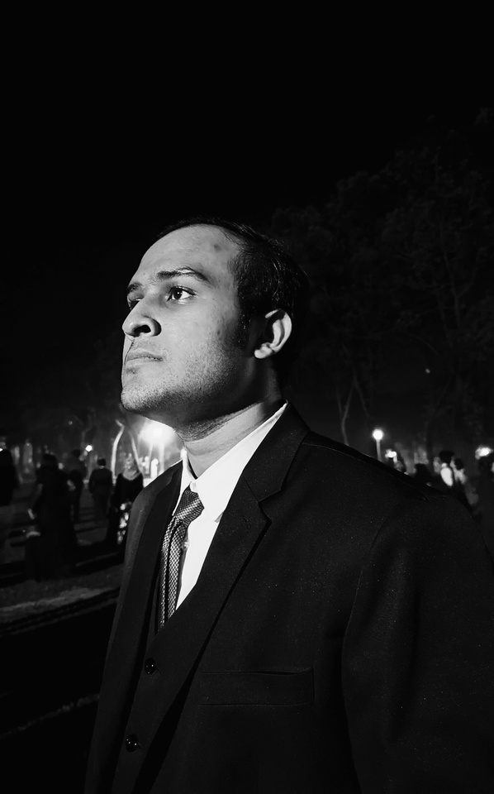

OUR GROUP MEMBERS
Group-11
FAIYAZ BIN YOUSUF
ASIEF IQBAL DIEYAZ
ID - 22101845
ID - 23341081
CSE424

Slide 3
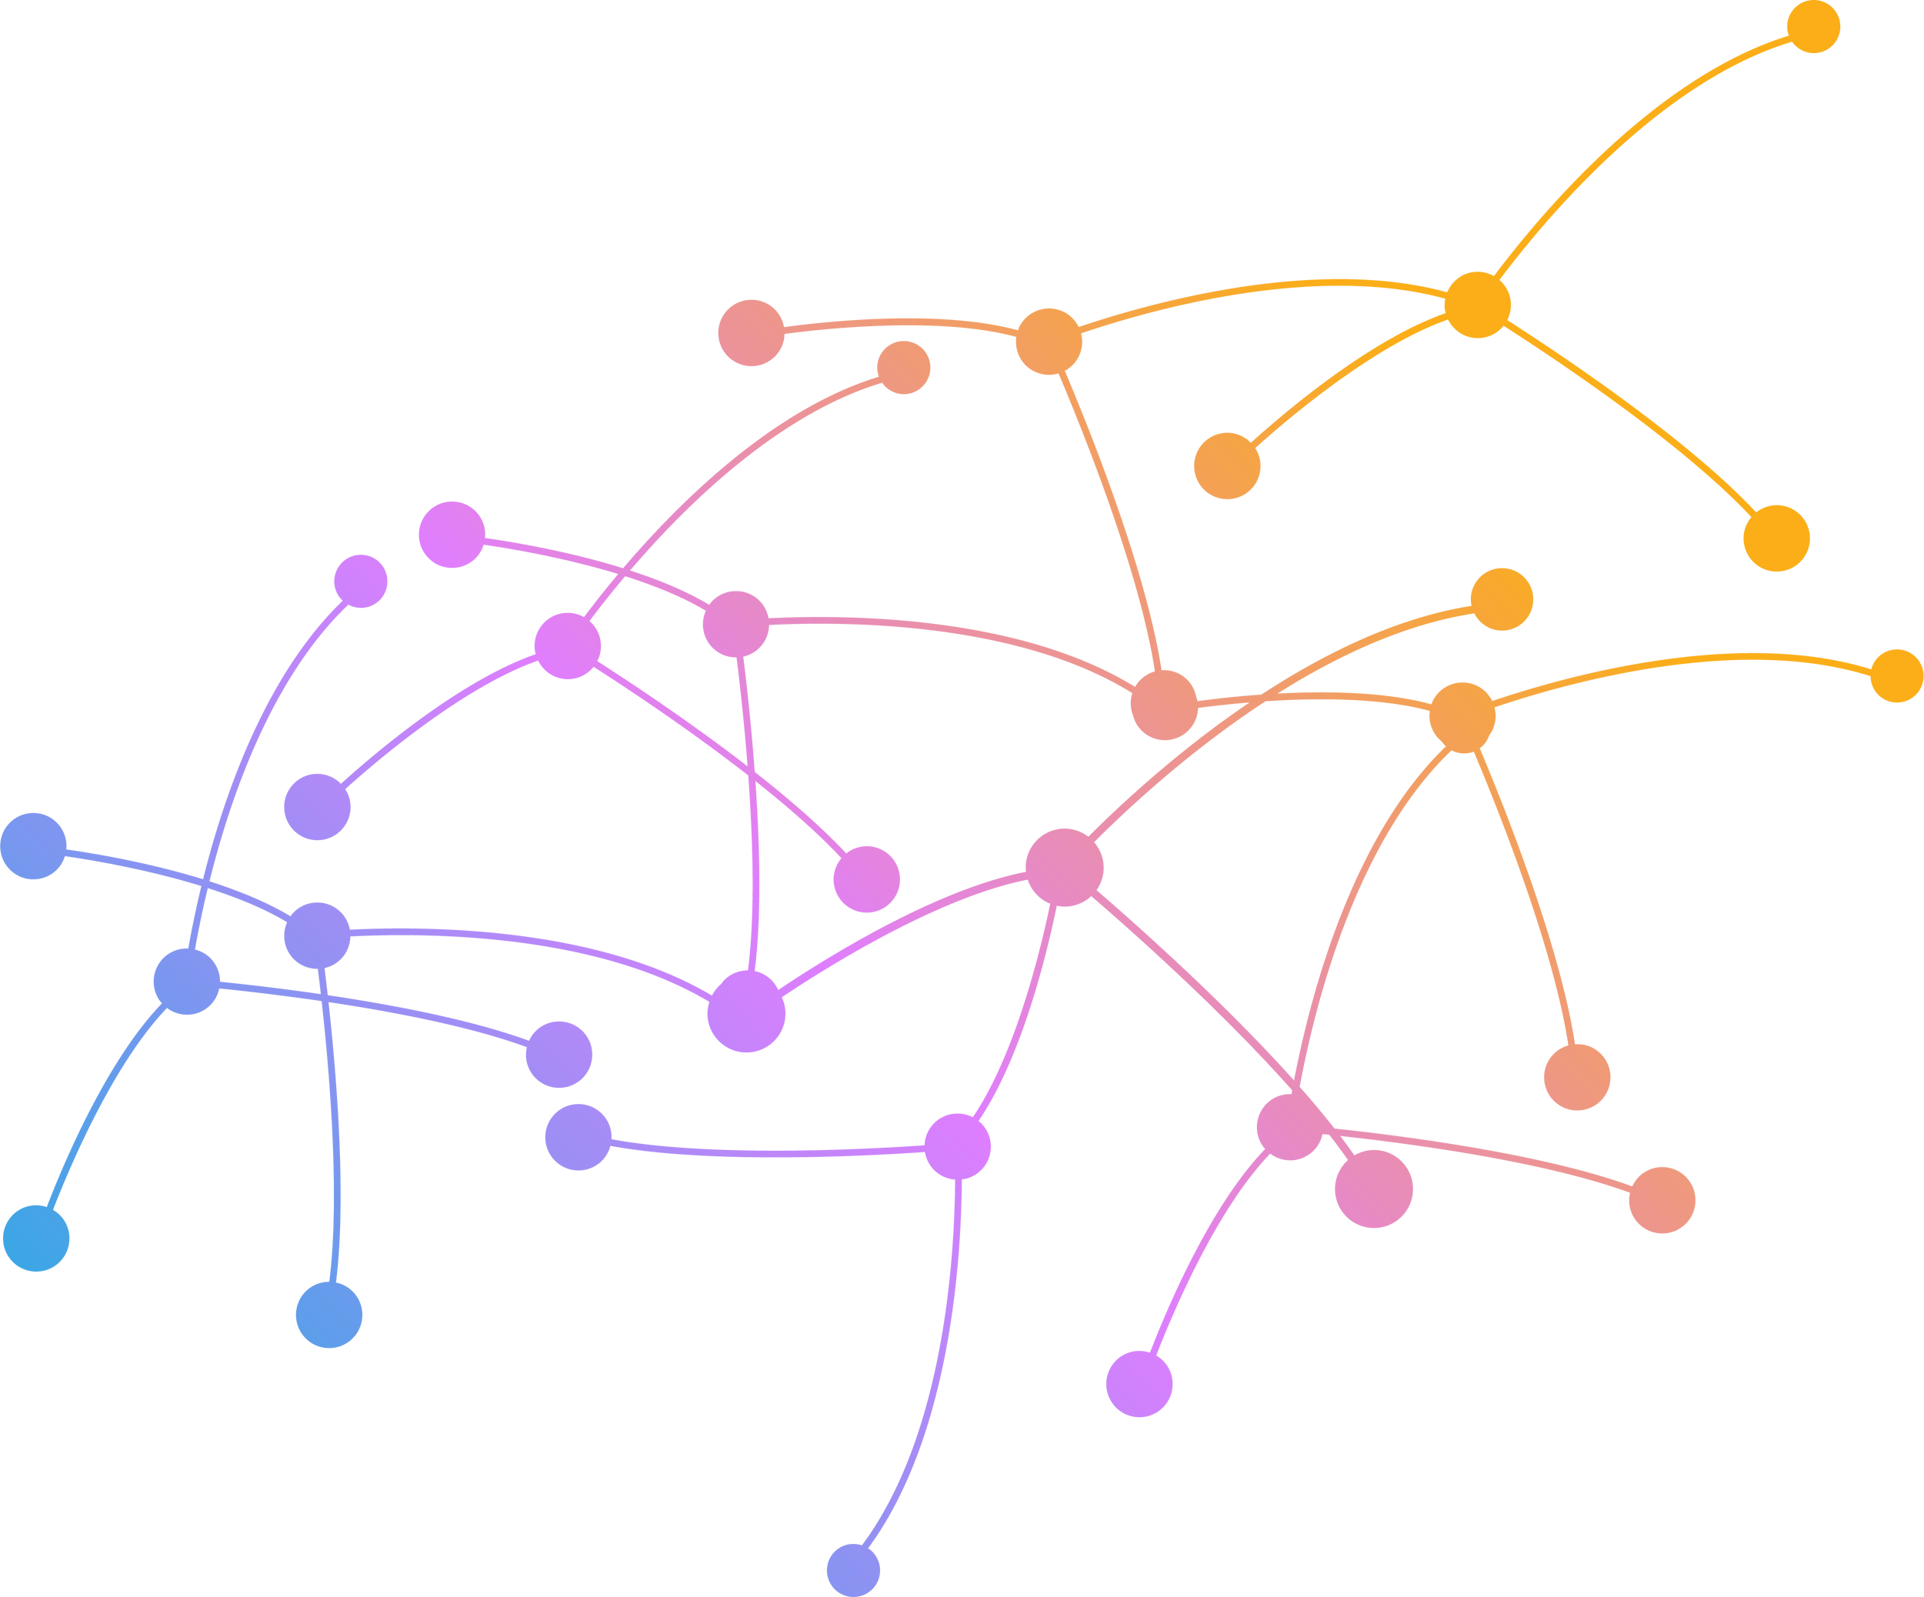
OUTLINE
INTRODUCTION
OUR APPROACH
MOTIVATION
CHALLENGES
FAIYAZ
DIEYAZ
RELATED WORKS
FUTURE SCOPE
BACKGROUND
CONCLUSION

Slide 4

INTRODUCTION
A RESEARCH BASED ON AN UNIQUE AND NOVEL APPROACH: A HYBRID CNN-SVM MODEL FOR MULTI-MODAL ANALYSIS
A RESEARCH DEDICATED TO ACCURATELY DETECT MENTAL DISORDERS LIKE SCHIZOPHRENIA, DEPRESSION, ANXIETY, PTSD AND MANY MORE
CSE424

Slide 5


MOTIVATION
Constant increment of psychiatric disorders globally.
Limited accessibility to accurate diagnostic tools.
Potential impact of advanced technology on diagnosis and treatment.
Lack of automated systems for the detection of mental health issues
“1 in every 8 people in the world live with a mental disorder” - World Health Organization (WHO)

Slide 6

RELATED WORKS
Saidi, A., Othman, S. B., & Saoud, S. B. (2020). “Hybrid CNN-SVM classifier for efficient depression detection system.” 2020 4th International Conference on Advanced Systems and Emergent Technologies (IC_ASET).
Hossain Shuvo, M. M., Ahmed, N., Nouduri, K., & Palaniappan, K. (2020). A Hybrid Approach for Human Activity Recognition with Support Vector Machine and 1D Convolutional Neural Network. 2020 IEEE Applied Imagery Pattern Recognition Workshop (AIPR).
Ming-Hsien Hiesh, Lam, Y.-Y. A., Chia-Ping Shen, Wei Chen, Feng-Shen Lin, Hsiao-Ya Sung, … Feipei Lai. (2013). Classification of schizophrenia using Genetic Algorithm-Support Vector Machine (GA-SVM). 2013 35th Annual International Conference of the IEEE Engineering in Medicine and Biology Society (EMBC).
Hu, M., Sim, K., Zhou, J. H., Jiang, X., & Guan, C. (2020). “Brain MRI-based 3D Convolutional Neural Networks for Classification of Schizophrenia and Controls.” 2020 42nd Annual International Conference of the IEEE Engineering in Medicine & Biology Society (EMBC).

Slide 7
BACKGROUND
EEG IN PSYCHIATRIC RESEARCH:
EEG (Electroencephalography) records brain electrical activity, which is crucial in psychiatric research for capturing neural oscillations. Abnormal EEG patterns, associated with disorders, offer insights into cognitive functions and emotional states. There have been more than hundreds of research papers dedicated to EEG functions mapping brain disorders.
SIGNIFICANCE OF AUDIO ANALYSIS IN UNDERSTANDING EMOTIONAL STATES:
Audio analysis is vital for analyzing emotional states by examining voice pitch, tone, and speech patterns. It provides valuable cues for emotional well-being and complements EEG data, contributing to a comprehensive understanding of psychiatric conditions.
OVERVIEW OF EXISTING MODELS (CNN, SVM) IN HEALTHCARE:
Convolutional Neural Networks (CNN) and Support Vector Machines (SVM) are prevalent models in healthcare. CNN excels in image analysis, while SVM is effective in classifying data, both offering potential applications in our hybrid model for psychiatric disorder analysis.
CSE424

Slide 8
OUR APPROACH
CNN
SVM
Hybrid Model
ML
Hyper parameter tuning
Random Forest
METHODOLOGY
SVM for EEG
Recognition
4 fold cross validation
EEG Recording
Multi-modular Approach
CNN for Speech Recognition
Spech Recognition
CSE424

Slide 9




CHALLENGES
DATASET COLLECTION
DATA TRAINING AND TESTING
Finding a multimodal dataset is very hard
Large scale data requires a lot of time
FEATURE EXTRACTION
COMPLEX ALGORITHM
Need to extract EEG and audio feature in the same time
Combining CNN and SVM is a complex process
CSE424

Slide 10

Clinical Psychology
This would benefit those suffering from clinical depression
Scalability
The research can be used in wide scale medical research
FUTURE SCOPE
Adaptability
On-time mental health disorder detection i.e. smartphones and wearables
Improved accuracy
The hybrid multimodal technique can give us a much better accuracy and robustness
CSE424

Slide 11


CONCLUSION
HYBRID ALGORITHM
The use of hybrid CNN-SVM model.
MULTIMODULAR METHOD
The use of both audio and EEG for robust analysis.
POTENTIAL IMPLICATIONS
This project has broader implications for clinical psychiatry
CSE424

Slide 12
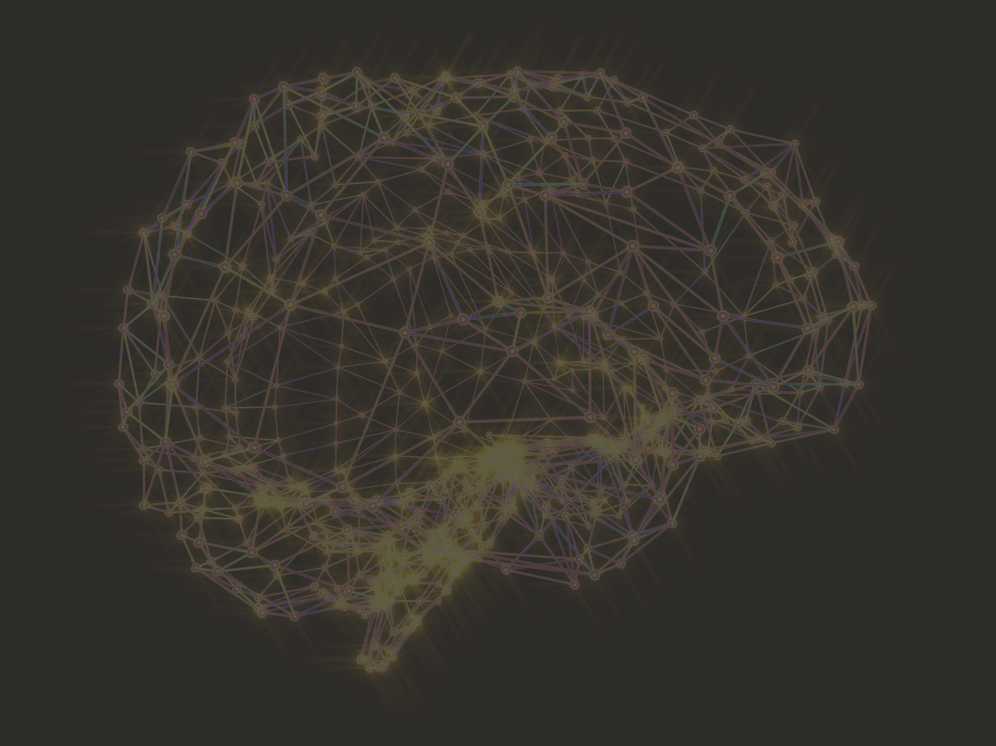
THANK YOU

